Slide 1
Project Management for Public Health Professionals
February 2011
David Sabapathy, MD, MBA, PEng
Department of Community Health Sciences
3rd floor TRW building
Faculty of Medicine
University of Calgary
Calgary, Alberta
Canada T2N 4Z6
david.sabapathy@albertahealthservices.ca
Notes:
Course prep:
Name plates or names written down
Student introductions
Survey the learners
Introduce Parking Lot

Slide 2
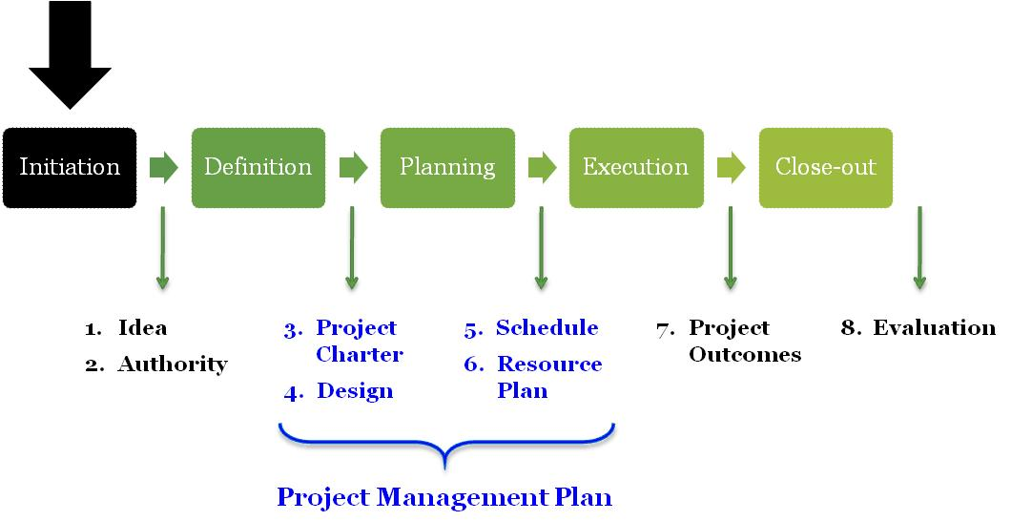
Section 1 Introduction to Project Management

Slide 3
Ideas
Initiation  Definition  Planning  Execution  Close-Out
Notes:
Have you ever had a great idea? What happened to that idea?
Thomas Alva Edison (February 11, 1847 – October 18, 1931) was an American inventor, scientist, and businessman who developed many devices that greatly influenced life around the world, including the phonograph, the motion picture camera, and a long-lasting, practical electric light bulb. Dubbed "The Wizard of Menlo Park" (now Edison, New Jersey) by a newspaper reporter, he was one of the first inventors to apply the principles of mass production and large teamwork to the process of invention, and therefore is often credited with the creation of the first industrial research laboratory. Thomas Alva Edison held 1,093 patents for different inventions.
However, not everything he created was a success; he also had a few failures. The greatest failure of Thomas Edison's career was his inability to create a practical way to mine iron ore. He worked on mining methods through the late 1880s and early 1890s to supply the Pennsylvania steel mills' demand for iron ore. In order to finance this work, he sold all his stock in General Electric, but was never able to create a separator that could extract iron from unusable, low-grade ores. Eventually, Edison gave up on the idea, but by then he had lost all the money he'd invested.
What do we know about ideas?
>99% of inventions fail. Only 2 products are launched out of every 3,000 ideas. (Jeannie Mandelker, Reporter Associate: Anne Ashby Gilbert, Marketing, Your Company, pp. 54+, October 1, 1997)
Research findings vary, ranging from fifty to ninety percent of innovation projects judged to have made little or no contribution to organizational goals. One survey regarding product innovation quotes that out of three thousand ideas for new products, only one becomes a success in the marketplace
Why?

Slide 4
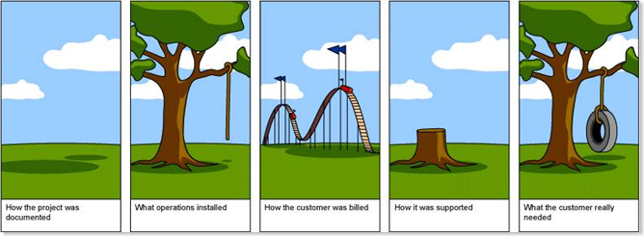
Outcomes
Initiation  Definition  Planning  Execution  Close-Out
Notes:
The causes of failure have been widely researched and can vary considerably. Some causes will be external to the organization and outside its influence of control. Others will be internal and ultimately within the control of the organisation. Internal causes of failure can be divided into causes associated with the cultural infrastructure and causes associated with the innovation process itself.
Failure in the cultural infrastructure varies between organizations but the following are common across all organisations at some stage in their life cycle (O'Sullivan, 2002):
Poor Leadership
Poor Organization
Poor Communication
Poor Empowerment
Poor Knowledge Management
Common causes of failure within the innovation process in most organizations can be distilled into five types:
Poor goal definition
Poor alignment of actions to goals
Poor participation in teams
Poor monitoring of results
Poor communication and access to information
In other words: “What we want is not what we get”. How to bridge this gap?

Slide 5
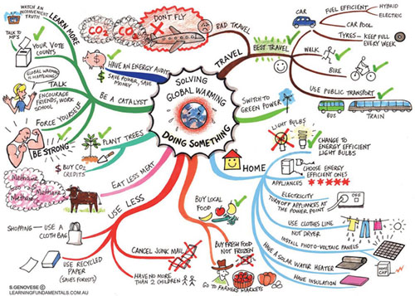
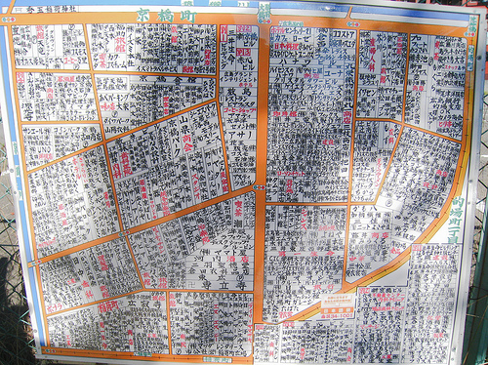
Implementation
Initiation  Definition  Planning  Execution  Close-Out
Notes:
During the health needs assessment week you learned the demographic and surveillance principles required as inputs to health priority setting (i.e. steps 1-3 of the U.K. National Institute for Health and Clinical Excellence’s Health Needs Assessment Process):
You now have an idea of how to go about establishing health priorities at a local and national level
You may have chosen a specific health priority that you want to start improving
How do we go about achieving this health priority? How do we avoid the pitfalls between having an idea, having a vision of what we want and realizing that vision with tangible results?
Often it is during the execution of an operational plan that progress towards health objectives is stymied. There are many causes for such difficulty including
insufficient and inconsistent resourcing
loss of interest due to drifting scope and priorities
excessive delays waiting for materials or services
loss of morale due to poor communication
lack of management support as a result of uncertain outcomes
Some of these problems are unavoidable and beyond the control of the public health practitioner. However many obstacles can be overcome using a structured approach to achieving health objectives.
Project management is a widely-adopted structured method for achieving health objectives in an effective and efficient manner. Effectiveness speaks to the approach’s retention of focus on the key health objectives (i.e. achieving the quality outcomes we want). Efficiency refers to accomplishing these objectives in a timely, cost-effective manner.
Project management is both an approach and a learned skill that can be used to develop, carry-out and communicate execution plans for health initiatives at a national and local level.
Project management is a process that can be used to complete the entire National Institute for Health and Clinical Excellence Health Needs Assessment Process or just a portion of this process. The case study in this course corresponds roughly to Steps 3 and 4
Pictures of confusing maps: ‘How to combat Global Warming’ and ‘Community map in a small suburb of Hiroshima’

Slide 6
Innovation = Ideas + Project Management
1. Innovation is important in Public Health
2. Innovation starts with an Idea
3. Project Management achieves that Idea
Initiation  Definition  Planning  Execution  Close-Out
Notes:
Innovation = Ideas + Project Management

Slide 7
Specific Learning Objectives
Describe a project management approach, its benefits and limitations and criteria for success
Describe the project life cycle’s stages and outcomes
Outline how to complete the following steps in the project life cycle
Initiation
Use the project life cycle to address a health priority for a developing country
Initiation
Conceive of a project idea
Identify the project sponsor and stakeholders
Initiation  Definition  Planning  Execution  Close-Out
Notes:
Specific learning objectives for Section 1: Introduction to Project Management (Initiation)

Slide 8
Topics
Project Management Approach
Difference between project and program
Project examples (Tanzania and Canada)
Pros/cons of alternatives to project management
Benefits and limitations
Criteria for project success
Project Management Components
Stages
Outcomes
Project management tools
Project Life Cycle: Stage 1 - Initiation
Idea
Authority
Initiation  Definition  Planning  Execution  Close-Out
Notes:
Topics for Section 1: Introduction to Project Management (Initiation)

Slide 9
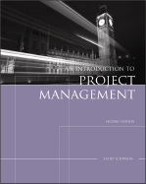
Project Management Approach
Initiation  Definition  Planning  Execution  Close-Out
Notes:
In this sub-section we’ll discuss what a project management approach means, give some examples and describe when and when not to consider using this approach for accomplishing a health priority

Slide 10
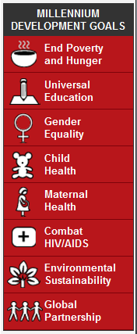
Millennium Development Goals
Significant progress worldwide
Five years left until the 2015 deadline
Goal 4: Reduce Child Mortality
Target: Reduce by 2/3 the <5 mortality rate
Indicators
Under-five mortality rate (UNICEF-WHO)
Infant mortality rate (UNICEF-WHO)
Proportion of 1 year-old children immunized against measles (UNICEF-WHO)
Initiation  Definition  Planning  Execution  Close-Out
http://www.unmillenniumproject.org/goals/index.htm
Notes:
At the Millennium Summit in September 2000 the largest gathering of world leaders in history adopted the UN Millennium Declaration, committing their nations to a new global partnership to reduce extreme poverty and setting out a series of time-bound targets, with a deadline of 2015, that have become known as the Millennium Development Goals.
The Millennium Development Goals (MDGs) are the world's time-bound and quantified targets for addressing extreme poverty in its many dimensions-income poverty, hunger, disease, lack of adequate shelter, and exclusion-while promoting gender equality, education, and environmental sustainability. They are also basic human rights-the rights of each person on the planet to health, education, shelter, and security.
The world has made significant progress in achieving many of the Goals. Between 1990 and 2002 average overall incomes increased by approximately 21 percent. The number of people in extreme poverty declined by an estimated 130 million. Child mortality rates fell from 103 deaths per 1,000 live births a year to 88. Life expectancy rose from 63 years to nearly 65 years. An additional 8 percent of the developing world's people received access to water. And an additional 15 percent acquired access to improved sanitation services.
Only five years left until the 2015 deadline to achieve the Millennium Development Goals

Slide 11
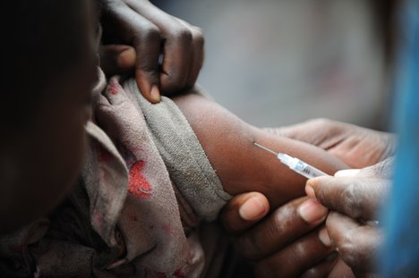
Measles Immunization Project (MIP)
Local measles immunization rates falling for one year-olds
Project launched to increase coverage rates
Goal: “Minimize the risk of measles by increasing immunization rates”
Initiation  Definition  Planning  Execution  Close-Out
Notes:
We will use an example of a health priority for the remainder of the week to illustrate the project management concepts as they are taught
Working through the project management process for this health priority, we will complete examples in class that demonstrate how the didactic material should be implemented.
These worked examples will be identical in structure to the activity modules which you will be completing.
The activity modules in turn come together to form the final project presentation
Let’s assume that in alignment with the MDGs you are looking to increase immunization coverage rates for one-year old children. However when you look into the situation you find that measles vaccination coverage rates in your local area are actually falling rather than rising for one year old children
You call a meeting at your local health department. The group consensus is to launch an initiative to increase measles immunization in your community. From your MPH training you recall that a targeted project would likely be the best way to go about this. You suggest this and the group gets excited. There is consensus that we should start a project and give it the name “Measles Immunization Project” with the acronym MIP.
Next steps are left with you. As you leave the meeting you think of a good goal for the project “To minimize the risk of measles, a vaccine preventable disease, as evidenced by an increase in immunization rates”
Time to review what you know about project management and get started!!!

Slide 12
What is a Project?
A project is a time-limited method to complete a series of activities leading to a specific outcome given a fixed timescale and resources
Initiation  Definition  Planning  Execution  Close-Out
Notes:
One definition of project management
Activities are always required to achieve health objectives. But these activities can be either ongoing or have a defined start and finish. What makes a project unique is two things:
It as a defined start and end point during which…
It creates a unique product or service. This product or service outcome can be either tangible (autos), or intangible (restructured department).

Slide 13
What is a Project?
Any workplace has 2 types of activities
Ongoing operations (e.g. programme)
One-time tasks (e.g. project)
Two unique characteristics of projects:
1. Defined start and end (i.e. temporary, one-time)
2. Creates a unique product or service
Initiation  Definition  Planning  Execution  Close-Out
Notes:
You might say that this sounds the same as what goes on during any ongoing health program (i.e. a number of activities are identified and performed within some constraints). But with ongoing health programs a similar product or service is being produced on a day-to-day basis and there is no defined endpoint. This distinction is very important. For example, if you don’t distinguish projects from programs then:
When you have ongoing changes in a program, you may try to manage these as projects only to find that the projects never end!
When you have a unique product/service to create within a timeline, you may try to accomplish this during day-to-day operations and find it never gets done (or gets done poorly)!
The challenge with projects is that they are organizational anomalies. They may cross department boundaries, staff up for short periods, have different reporting relationships among the project team, use different funding sources other than the regular budget, etc.. Products have a tendency to break all the traditional rules of your organization for a short period of time. The temporary, ad hoc nature of products can create major problems if not dealt with correctly because they represent a temporarily “new way of doing things”
Yet undoubtedly the new structure and process around projects make them more efficient for the purpose of accomplishing a one-time objective
A programme is often viewed as a series of projects but this is a point of debate

Slide 14
Project Management or Not?
Projects
Canada
Electronic Health Record
WHO Safe Surgery Checklist
AHS Patient Safety Reporting System
Tanzania
Pathfinder International – Community home-based care
AMREF - HIV voluntary counselling and testing services
SDC – Insecticide-treated bed-net distribution
Not Projects
Routine vaccination, HIV treatment, ongoing research
Initiation  Definition  Planning  Execution  Close-Out
Notes:
Canada
Electronic Health Record - In its 1999 final report, Canada Health Infoway: Paths to Better Health, the Advisory Council on Health Infostructure recognized that "the Canada Health Infoway will become the key information and communications foundation for our health care system in the 21st century."(1) To support this national "infoway," the Advisory Council identified two key components, the EHR and telehealth.
WHO Safe Surgery Checklist - The goal of the Safe Surgery Saves Lives Challenge is to improve the safety of surgical care around the world by ensuring adherence to proven standards of care in all countries. The WHO Surgical Safety Checklist (above) has improved compliance with standards and decreased complications from surgery in eight pilot hospitals where is was evaluated.
Alberta Health Services – Patient Safety Reporting System - to capture adverse events in a hospital setting and to use this information to improve patient safety
Tanzania
Pathfinder International NGO “Global Leader in Reproductive Health” Integrated Reproductive Health and Family Planning - In Tanzania, the program centers on increasing family planning services and reducing unwanted pregnancies in Dar es Salaam, Arusha, and Kilimanjaro through a combination of community home-based care and clinic-based service delivery. This focus is being integrated into the highly successful community home-based care program that has been serving people living with HIV/AIDS and families affected by the pandemic.
African Medical & Research Foundation (AMREF) “Africa’s leading health development organisation” - The Angaza project, meaning ‘shed light’ in Kiswahili aims to remove the stigma surrounding HIV/AIDS and therefore reduce the spread of the disease by:
Encouraging every Tanzanian to know their HIV status
Increasing access to quality testing and counselling services
Providing community care support for those with HIV/AIDS
Using rapid HIV tests which are accurate, easy to perform, low cost and which require minimal laboratory equipment
Training voluntary counselling and testing counsellors
Increasing social marketing campaigns to improve awareness of testing sites and to dispel myths and stigma surrounding the disease
Swiss Agency for Development and Cooperation (SDC) has been developing a public-private partnership which has enabled, pregnant women, mothers and their young children to access subsidised bed nets to keep away malaria-carrying mosquitoes.
What things are you working on locally that maybe consider projects?

Slide 15
Many Ways to “Get Things Done”
Alternatives to project management:
Just Do It - “Roll up your sleeves”
Collaborative – “Meetings, meetings, meetings”
Divide and Conquer – “Let’s break it down”
Old Faithful – “Go with what works”
“To Do” List – “Mark it down and it will get done”
Others…
Initiation  Definition  Planning  Execution  Close-Out
Notes:
There are many ways to accomplish one-time objectives but often effectiveness and efficiency are lacking. Some alternatives to projects include:
Collaborative approach – meet as strictly as possible so you can stay on top of all the issues
Pros: good for team-building, fills in unwritten gaps
Cons: slow, inefficient process with substantial rework
Just Do It approach – no need for a plan, let’s just get to work
Pros: quick successes, motivating for the team
Cons: inability to handle complexity, significant rework
Divide and Conquer – split up the task to be done and gather together when everyone’s completed their piece
Pros: time saved not in meetings, efficient work on each piece
Cons: difficult to manage interconnectivity of tasks, and goal becomes hazy
Old Faithful – reference an old way of doing things
Pros: if process is time-tested it may now be efficient
Cons: unable to handle flexibility, innovation is lost
“To Do” List – one big “to do” list managed by entire team
Pros: no tasks are missed, feeling that we are moving ahead together
Cons: task interdependencies often overlooked, risks and contingencies not addressed

Slide 16
Benefits
Effective and efficient way of “getting things done”
Effective – right outcomes
Efficient – minimal use of resources
Handles increasing complexity and rates of change
Builds team confidence in addressing health priorities
Initiation  Definition  Planning  Execution  Close-Out
Notes:
A project management approach is a way of making sure that our health program objectives are attained and produce the right outcomes (functionality - doing what its supposed to and performance – how well the functionality works) with the minimal use of resources (time, money, stress, trust, etc.). A project management approach includes many tools and techniques that make project management easier
Project management is a way of handling complex relationships, projects can be used to handle large health program initiatives. With these complex relationships mapped, projects can be quickly adapted to changes in one’s environment
The structured approach to project management builds team confidence
Project Management is a widely applicable to a broad variety of health program initiatives and is an underused tool in improving local and national health priorities
Originated in industry and has wide application
Increasingly relied upon in complex environments
Growing career path as a project manager

Slide 17
Limitations
Applies only for activities with
Defined start and end (i.e. temporary, one-time)
Creating a unique product or service
Not for emergencies
Requires cultural adaptation
Unique requirements
Personnel, authority, budgeting, controls, communication, etc.
Initiation  Definition  Planning  Execution  Close-Out
Notes:
Per definition of Project vs. Program
While emergency requires a planned approach that is often worked out in advance, this is more of a strategic plan (more on plans later). Project management is a planned approach to executing a health program initiative and is inapplicable to emergency situations
The project management approach that we will be covering will require your special skills in adapting this method to your local context. A structured approach to ”getting things done” does not preclude sensitivity to the way people traditionally work

Slide 18
Five Rules for a Successful Project
Stakeholder agreement on
goals of project
Effective communication
among stakeholders
Controlled scope
Plan with clear schedule and responsibilities
Management support
Initiation  Definition  Planning  Execution  Close-Out
Notes:
You will notice that three of these five rules directly involve the most tricky variable of all: people. “Agreement among stakeholders regarding goals of the project”, “Constant, effective communication among stakeholders”, and “Management support” when you move beyond the actual task are all a matter of interpersonal relationships. Thus project management is just as much about managing people as it is about managing data and things. We will discuss throughout this course some examples and suggestions of how to work with people in a way that aligns with these three rules for a successful project
The two remaining rules “Plan with clear schedule and responsibilities” and “Controlled scope” will be dealt with in detail in the coming sections

Slide 19
A Project is Deemed Successful If…
The ‘Triple Constraint’:
Outcomes = Time + Resources
Outcomes
Resources
Time
Initiation  Definition  Planning  Execution  Close-Out
Notes:
Introduce triple constraint as a key concept
What makes a successful project? It is a matter of achieving or surpassing our outcomes (scope and quality of outcomes) within a given time (schedule) and resource constraints (financial, staffing, etc.). This is often known as the triple constraint. Fast food example
Increased Scope / Quality of outcomes = increased time + increased resources
Tight on Time = increased resources + reduced scope / quality
Tight on Resources = increased time + reduced scope / quality

Slide 20
A Project is Deemed Successful If…
Therefore happiness is…
Accepted by Stakeholders (Expectations)
Within Resources
On Time
Outcomes Achieved
Initiation  Definition  Planning  Execution  Close-Out
Notes:
Satisfy triple constraint
But also… it can be equally or even more important that there is a perception that we have achieved success. As the project outcome been accepted by the stakeholders? Have we met or exceeded their expectations? Thus when it comes to project communication, managing expectations can be very important

Slide 21
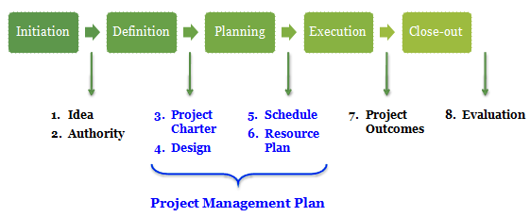
Project Life Cycle
Initiation  Definition  Planning  Execution  Close-Out
Notes:
Now let’s talk in more detail about what we mean by project management. In this sub-section we will discuss a process for project management i.e. the Project Live Cycle
We will also complete the first step in this process, Initiation, which has two outcomes:
Idea
Authority

Slide 22
Project Life Cycle
The Project Life Cycle – 5 Stages
Initiation
Definition
Planning
Execution
Close-out
Idea
Authority
Project Charter
Design
Schedule
Resource Plan
Project Outcomes
Evaluation
Project Management Plan
Initiation  Definition  Planning  Execution  Close-Out
Notes:
Remember that we have a great idea! And all we want to do now is make it happen!
We’ve identified that one way to make an idea happen is to implement it using a project management approach. A project management approach is the process of going from the idea to the outcome. This process is what we call the Project Life Cycle and we will use it as our map for this course
The Project Life Cycle has 5 stages each with its own outcomes:
Initiation - Someone (you!) has a great idea about how to improve a health priority. Your idea is endorsed by someone who has the political, social, financial authority to act. Outcomes:
Project Idea - An idea about how to improve the existing situation
What things are we concerned about? (i.e. in and out of scope)
What is wrong with the existing situation?
How will things be better when we are done?
How do we expect the new system to perform (i.e. performance criteria)
What are the constraints? (i.e. quality, cost, time, flexibility)
Authority - Assignment of an individual with the Authority to act (Sponsor)
Definition - Agreement of the authority to begin work and an unmistakable description of the deliverables. Outcomes:
Project Charter – gives the project team the right/authority to begin the project
Design – description of final deliverables (i.e. solution)
Preliminary design: Selection of best way to implement the idea within given constraints using problem solving, generation of options, feasibility analysis. Signoff by sponsor on proposed “best” solution.
Detailed design: Describe final deliverable (i.e. solution) in detail. Signoff by sponsor on work breakdown structure and cost estimate
Planning – The plan of how we will accomplish the idea on schedule and within resource constraints. Outcomes:
Schedule
Resource Plan - includes budget
Execution – Implementation of the project plan including measuring progress, managing risk, communicating and controlling for error. Outcomes:
Project Outcomes – the improved health outcomes for your health priority that you wanted to achieve
Close-out – Wrapping up the project
Evaluation – a review of the success, failures and continuous improvement opportunities over the project life cycle
This one-week course will focus on creating a Project Management Plan which is the sum of the outcomes from the Definition and Planning stages of the Project Life Cycle. The Project Management Plan = Project Charter + Design + Schedule + Resource Plan. From the Project Management Plan you are ready to enter the Execution stage and execute your Idea. With a Project Management Plan you have a much higher chance of making your idea than with no plan at all!
The Execution and Close-out stages will be covered briefly but would require more time than we have. If you complete the Project Management Plan its time to do some extra reading to prepare for execution and close-out! (references provided at the end of this course). But a good Project Management Plan already places you in an excellent position to accomplish your idea!

Slide 23
Project Life Cycle
The Project Life Cycle is a process for managing projects from Idea to Outcome
Initiation  Definition  Planning  Execution  Close-Out
Notes:
Ubiquitous
Constant reference point

Slide 24
Project Management Plan
The Project Management Plan is a final product of the Initiation, Definition and Planning stages and is used as a roadmap for Project Execution
Initiation  Definition  Planning  Execution  Close-Out
Notes:
Components and Purpose of the Project Management Plan

Slide 25
Project Life Cycle
Initiation
Definition
Planning
Execution
Close-out
Idea
Authority
Project Charter
Design
Schedule
Resource Plan
Project Outcomes
Evaluation
Project Management Plan
Initiation  Definition  Planning  Execution  Close-Out
Notes:
Let’s begin our journey on the Project Life Cycle
We start at the first stage: Initiation. We need to produce two outcomes: Idea and Authority
Let’s go back to our Measles Immunization Project (MIP) case study to determine these two outcomes

Slide 26
MIP Case: Initiation
Meeting with UNICEF scheduled
Several possible strategies identified
Bottom-up – from local providers
Top-down – literature review
Good relationships with local network of immunization providers
Idea! Authority?
Initiation  Definition  Planning  Execution  Close-Out
http://www.measlesinitiative.org
Notes:
As part of the Measles Initiative started in 2001, you have scheduled a meeting to discuss your local situation with a UNICEF representative (core founding members of the Measles Initiative alongside UNICEF include the United Nations Foundation, the World Health Organisation, the American Red Cross and the Centers for Disease Control and Prevention). They are excited to hear your department’s idea to run a project to increase measles immunization
Since 2001 the Measles Initiative has mobilized more than $144 million and has helped African countries vaccinate over 150 million children against measles.
There currently exists several immunization providers in your local area. Over the years, you have developed excellent relationships with these individuals. You discuss the situation with them and they provide several reasons why measles coverage rates may be falling
Vaccines occasionally out of stock
Health care providers not available to give vaccine; lack of volunteers to cover
Vaccine cold-chain supply breaks
Belief of particular religious groups around vaccination
Lack of social marketing
Parents unaware of vaccine availability and effects of measles disease
The local immunization providers also indicate that they have potential solutions to these problems if only someone would listen
Idea! You think it might be a great idea to gather these potential solutions, combine them with a literature review of best ways to increase immunization coverage, and apply the best solutions to the clinics of these immunization providers!
Recall that Stage 1: Initiation has two outcomes
An idea about how to improve the existing situation
What things are we concerned about? (i.e. in and out of scope)
What is wrong with the existing situation?
How will things be better when we are done?
How do we expect the new system to perform (i.e. performance criteria)
What are the constraints? (i.e. quality, cost, time, flexibility)
Assignment of an individual with the Authority to act (Sponsor)
We have the idea now but let’s be careful about who has given us the authority to act. Sometimes it is difficult to identify this individual. However often it is quite simply the person who is funding the project and has the most at stake in the outcome. Proceeding on a project without the endorsement of this individual can be tenuous at best. Always examine this issue carefully before proceeding with a project. In this case we’ll assume we have identified a sponsor and discuss this more as the case evolves.

Slide 27
Project Life Cycle
Initiation
Definition
Planning
Execution
Close-out
Idea
Authority
Project Charter
Design
Schedule
Resource Plan
Project Outcomes
Evaluation
✓
Project Management Plan
Initiation  Definition  Planning  Execution  Close-Out
Notes:
Stage 1: Initiation completed

Slide 28
Project Management Tools
Many tools to organize, analyze, measure, monitor project activities
Project Management software
Proprietary ($) e.g. Microsoft Project
Open Source e.g. Project Open
Productivity software
Proprietary ($) e.g. Microsoft Office: Word, Excel
Open Source e.g. Open Office – alternative to Microsoft Office
Initiation  Definition  Planning  Execution  Close-Out
http://en.wikipedia.org/wiki/Comparison_of_project_management_software
Notes:
In Section 2 we will look the Definition stage of the Project Life Cycle
Before we proceed, note that there an endless number of tools available to assist in working through projects. These tools fall into two categories:
Project Management software – specifically designed for running projects and includes tools for issue tracking, scheduling, resource management, document management, collaboration
Advantages – pre-packaged tools that don’t need to be designed by you
Disadvantages – often designed for large projects, this type of software can be complex to learn and harder to share among colleagues
Productivity software – this is software not specifically designed for project management can be used for this purpose
Advantages – many people feel familiar and comfortable with the software, can custom design your own tools, easy to share among colleagues
Disadvantages – takes time to develop your own tools, greater opportunity for error
Both types of software tools can be proprietary (i.e. requires a license and has a cost) or open-source (i.e. designed for sharing on the Internet and typically free)
I list one proprietary and open-source example for each type of tool
Recommendation: For small projects, Project Management software is not needed. In a pinch you can get away without using Productivity software (i.e. no software at all, only pen/pencil and paper) however knowledge of a word processor and spreadsheet can be very useful. Microsoft Office’s word processor (Microsoft Word) and spreadsheet (Microsoft Excel) applications do a nice job but require license. Open Office has word processor and spreadsheet applications that do just as nice a job and require no license.
In this course, we will use both a word processor and spreadsheet to complete the in-class case study. It is recommended but not required that you use a word processor to complete the activity modules and handouts for the final presentation. Anyone who is interested in learning more about Project Management software or Productivity software, please drop by after class to discuss

Slide 29
Final Presentation: Project Teams
Time to form Project Teams!
Four groups 4-5 students each. Assign project team roles
Project Manager
Project Team
Designer
Client/owner representative
Implementer
Decide on health priority of interest
Initiation  Definition  Planning  Execution  Close-Out
Notes:
Count off students 1-2-3-4… to ensure a random mix
More than one implementer for larger teams

Slide 30
End of Section 1 Introduction to Project Management

Slide 31
Project Management for Public Health Professionals
February 2011
David Sabapathy, MD, MBA, PEng
Department of Community Health Sciences
3rd floor TRW building
Faculty of Medicine
University of Calgary
Calgary, Alberta
Canada T2N 4Z6
david.sabapathy@albertahealthservices.ca
Notes:
Course prep:
Name plates or names written down
Student introductions
Survey the learners
Introduce Parking Lot

